Slide 1
ARTIFICIAL INTELLIGENCE
Deep Learning
Abdul ,Nissy ,Sajitha,Shini

Slide 2
Contents
Introduction
Deep Learning
Artificial Neural Network
Training & Testing
Hyper parameters
Convolutional Neural Network
Backpropagation
Conclusion

Slide 3
Artificial Intelligence
“The science and engineering of making intelligent machines, especially intelligent computer programs”. -John McCarthy

Slide 4
Artificial Intelligence
Artificial Intelligence is an approach to make a computer, a robot, or a product to think how smart human think. AI is a study of how human brain think, learn, decide and work, when it tries to solve problems. And finally this study outputs intelligent software systems.
The intelligence is intangible. It is composed of
Reasoning
Learning
Problem Solving
Perception
Linguistic Intelligence

Slide 5

Deep learning is a subset of machine learning
machine learning is a subset of AI
AI act as an umbrella term for any computer program that does something smart.

Slide 6
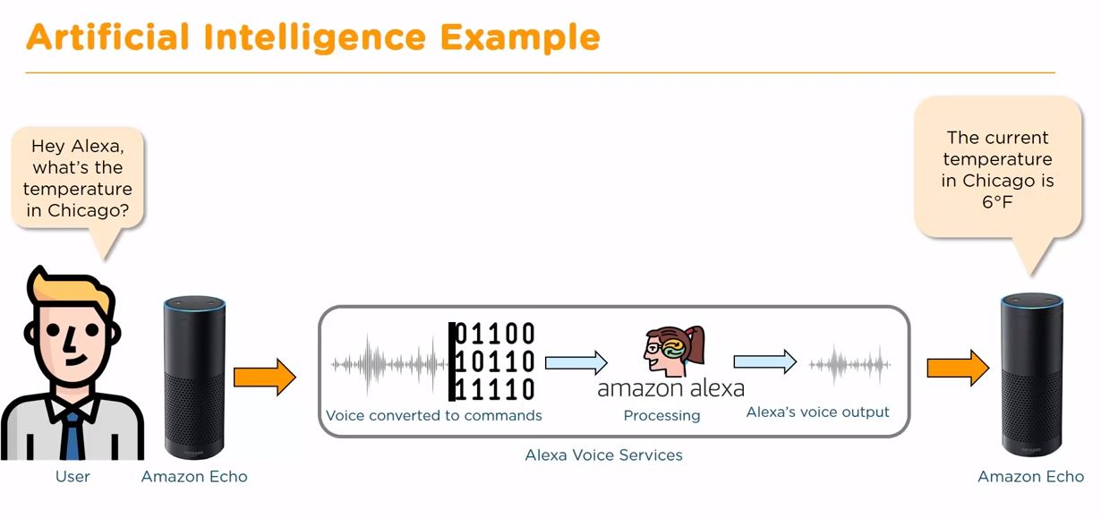
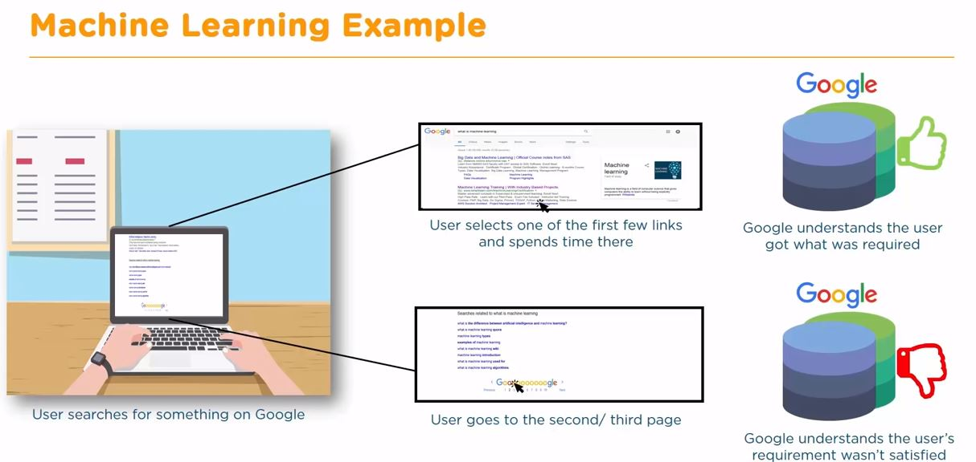
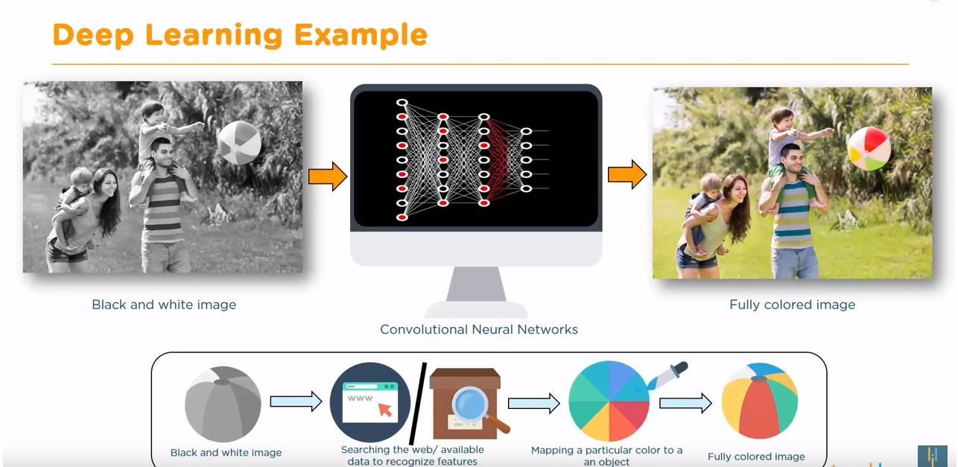

Slide 7
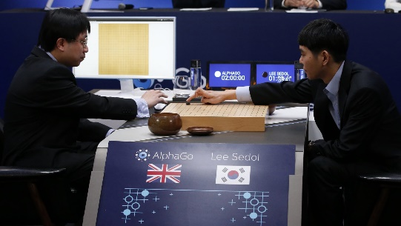

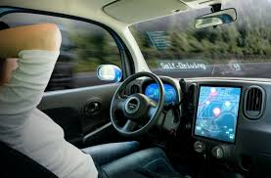


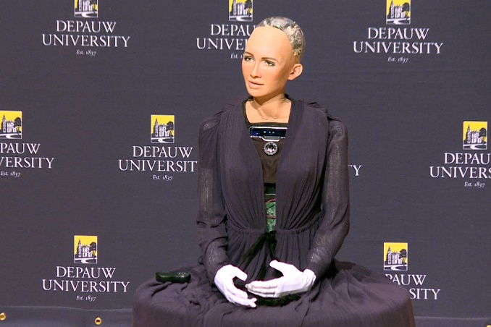




Applications of AI

Slide 8
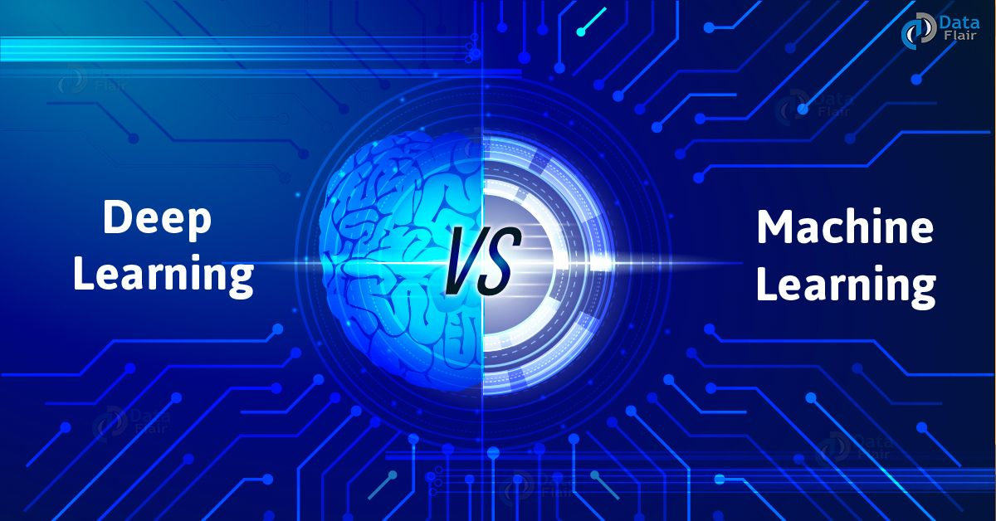
Data Dependencies
Hardware dependencies
Feature Engineering
Problem Solving Approach
Execution Time
Interpretability
dd

Slide 9
Deep Learning
Deep Learning is a subfield of Machine Learning that deals with algorithms inspired by the structure and the function of the brain.
Why do we need Deep Learning?
Process huge amount of data
Perform complex algorithms
To achieve the best performance with huge data
Feature Extraction

Slide 10
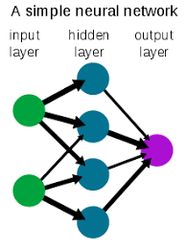
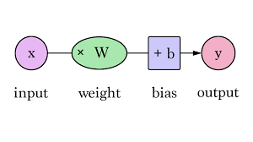
Layers in a Neural Network
Deep learning is based on the functioning of a human brain .Let’’s understood how does an Artificial Neural Network looks like.

Slide 11
Layers in an ANN
Dense(Fully connected) layer
Convolution layer
Pooling layer

Slide 12
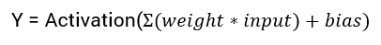
Activation Function in a Neural Network
Extremely important feature of the artificial neural networks.
They decide whether a neuron should be activated or not
When we do not have the activation function the weights and bias would simply do a linear transformation.
Neural network without an activation function is a regression model
Different types
Sigmoid Function
Rectified Linear Function

Slide 13
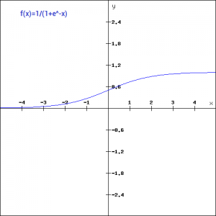
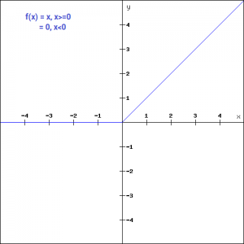
Sigmoid Function
Rectified Linear function

Slide 14
Choosing right activation function
However depending upon the properties of the problem we might be able to make a better choice for easy and quicker convergence of the network.
Sigmoid functions and their combinations generally work better in the case of classifiers
Sigmoids and tanh functions are sometimes avoided due to the vanishing gradient problem
ReLU function is a general activation function and is used in most cases these days
If we encounter a case of dead neurons in our networks the leaky ReLU function is the best choice
Always keep in mind that ReLU function should only be used in the hidden layers
As a rule of thumb, you can begin with using ReLU function and then move over to other activation functions in case ReLU doesn’t provide with optimum results

Slide 15

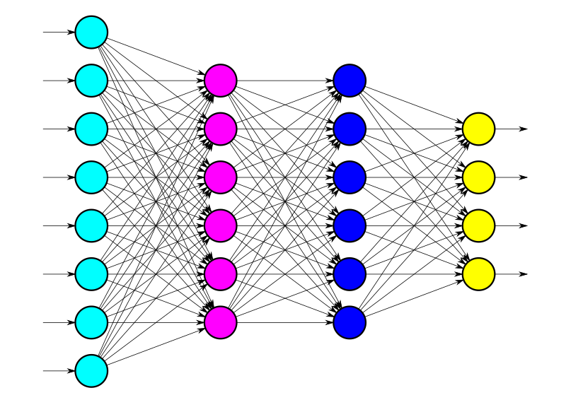
Training a Neural Network
Finding the weights that most accurately map our input data to the correct output class.
This mapping is what the network must learn.
During training the weights are iteratively updated
For this we use OPTIMIZATION ALGORITHMS
The most widely known optimizer is called stochastic gradient descent

Slide 16
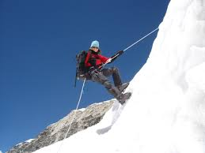
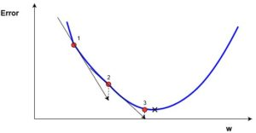
Gradient Descent
Gradient descent is an optimization algorithm used to find the values of parameters (coefficients) of a function (f) that minimizes a cost function (cost).
Gradient descent is best used when the parameters cannot be calculated analytically
one iteration of the gradient descent algorithm requires a prediction for each instance in the training dataset, it can take a long time when you have many millions of instances.Then we use Stochastic Gradient Descent

Slide 17
Stochastic Gradient Descent
The gradient descent procedure update the coefficients for each training instance
rather than at the end of the batch of instances.
STEPS
Order of the training dataset is randomized.
By mixing up the order for the updates to the coefficients, it harnesses this random walk and avoids it getting distracted or stuck.
The update procedure is same except the cost is not summed over all training patterns, but instead calculated for one training pattern.
The learning can be much faster
Small number of passes through the dataset to reach a good or good enough set of coefficients, e.g. 1-to-10 passes through the dataset.

Slide 18
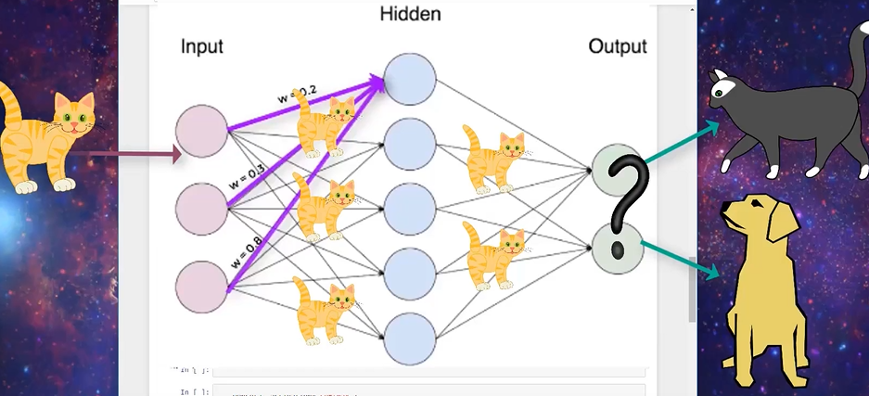
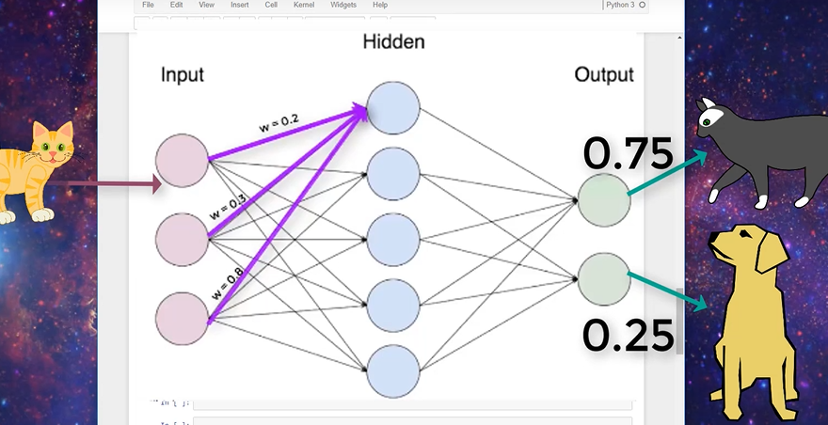
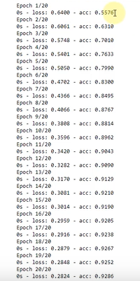
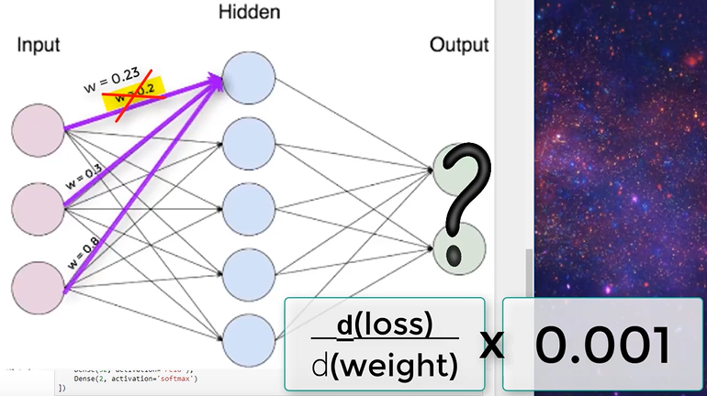
How a neural network learns?

Slide 19
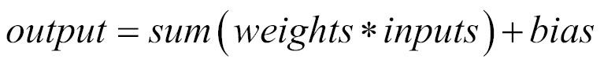
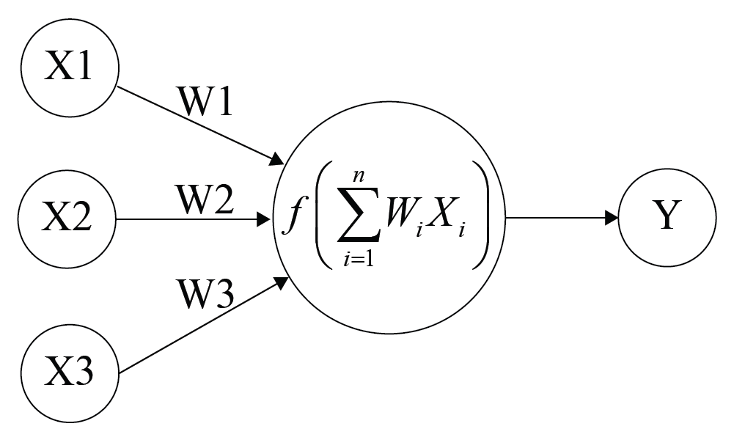
Learning Parameters
A parameter that is learned by the network during training.It includes weights and bias.
Weight : It is the strength of the connection.that is if we increase the input
The input how much influence does it have on the output.
Bias : 1.Makes the neuron active or inactive.
2.A bias value shift the activation function to the left or right.

Slide 20
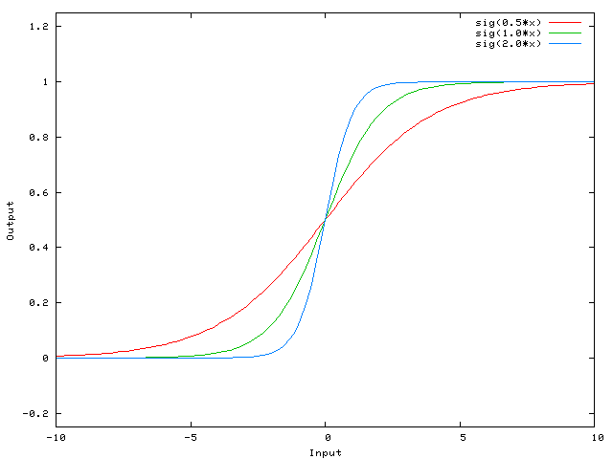
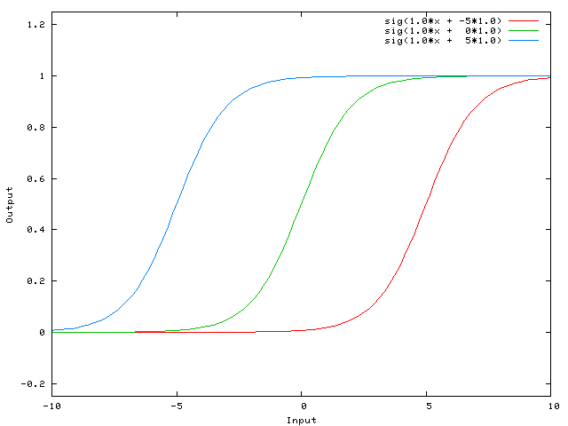
EFFECT OF BIAS AND WEIGHTS
Change in weights
Change in bias

Slide 21
Hyper Parameters
Determines the network structure and the variables which determine how the network is trained.
Hyper parameters to network structure
Hyper parameters to training algorithm

Slide 22
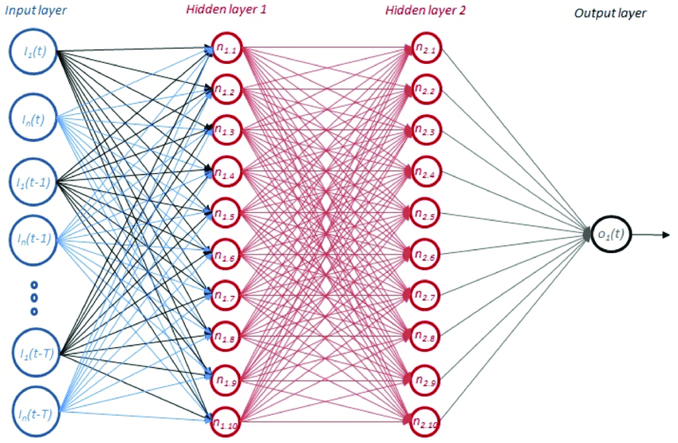
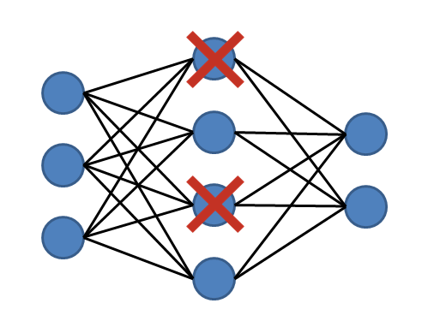
HYPER PARAMETERS TO NETWORK STRUCTURE
Number of hidden layers
Dropout
Regularization technique that randomly ignores subset of nodes in a given layer.And prevents dropped out nodes from participating and producing prediction on new data.

Slide 23
(Continuation…….)
3. Network weight initialization
Use different intalization schemes according to the activation function used on each layer.
1.Initializing all weights to zero
2.initializing weights randomly
Vanishing gradients
Exploding gradients
Avoided by
Using RELu activation function
Xavier initialization

Slide 24
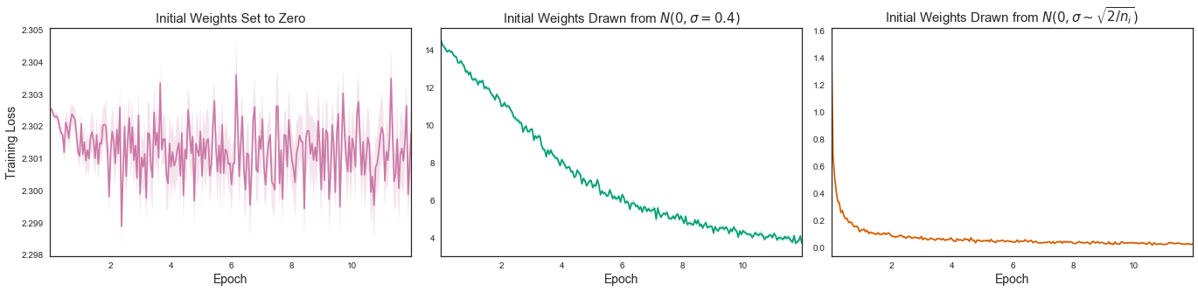
(Continuation…….)

Slide 25
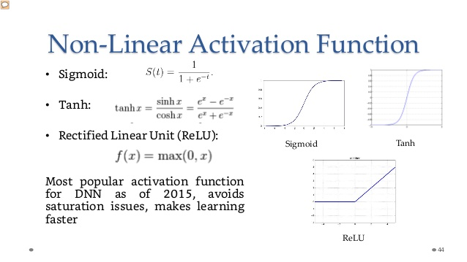
(Continuation…….)
4. Activation function
Used to introduce nonlinearity to model,which allows deep learning model to learn non-linear prediction boundaries.

Slide 26
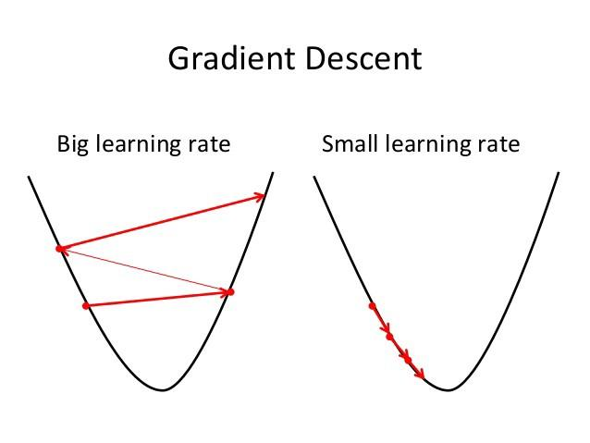
HYPER PARAMETERS TO TRAINING ALGORITHM
1.Learning rate
Refers to how quickly a network updates its parameters.Ranges between 0.01 to 0.0001.
Methods that can automatically adapt the learning
rate
Bold driver
Annealing rate
Local rate adaptation

Slide 27

Comparison

Slide 28
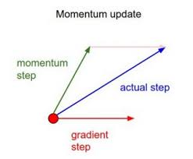
(Continuation…….)
2. Momentum
Know the direction of next step with the knowledge of previous steps to find the local minimum. So it can prevent oscillations and typical choice is 0.5 to 0.9.

Slide 29
(Continuation…….)
3. Number of epochs
Number of times the training data is shown to the network while learning.
4. Batch size
Number of samples that will be passed through to the network at one time.
Larger batches = Faster learning

Slide 30
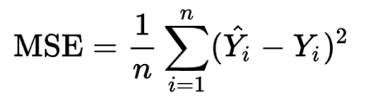
LOSS IN A NN
Measure the absolute difference between predicted value and actual value.
Types of loss function
1.
2. Likelihood loss
3. Log loss (Cross entropy loss)

Slide 31
TRAIN,TEST AND VALIDATION SETS
Input dataset is divided into train,test & validation set.
Training set : used to train the model during each epoch
Validation set : set of data separated from the training set used to validate our model during training.
Test set : set of data used to test the model after the model has already been trained.

Slide 32
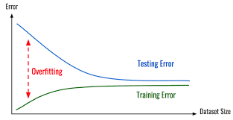
OVERFITTING IN A NN
Model is good to classify the datas in the training set.But it is not good at classifying data in the validation set.that is validation matrices are worse than the training matrices.
It can be reduced by
Add more data to our training set
Data augmentation
Reduce complexity of the model
Drop out

Slide 33
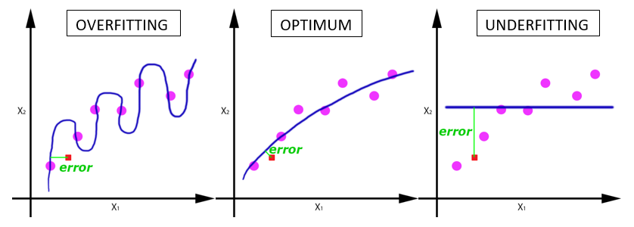
UNDERFITTING IN A NN
Model is not able to classify the data in the training set.Here the training loss is high.
It can be reduced by
Increase the complexity of the model
Add more features to the input sample in our training set
Reducing drop out

Slide 34
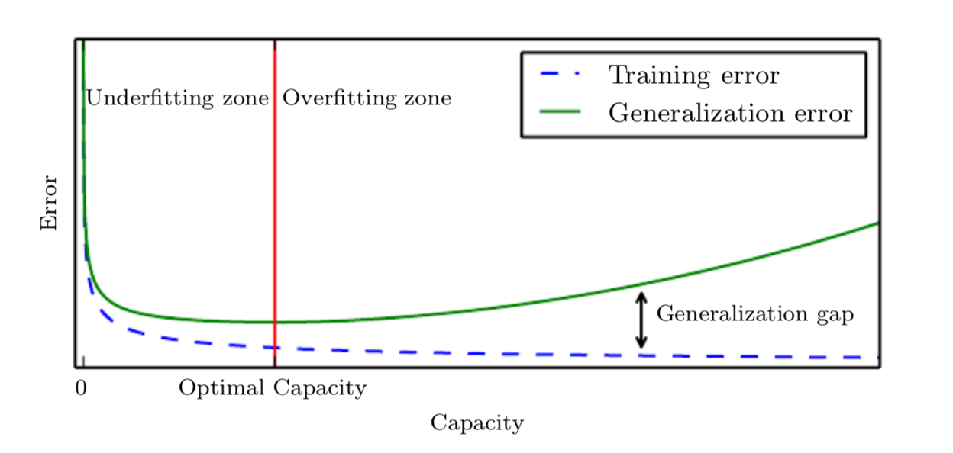
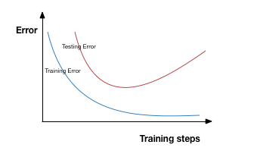
REGULARIZATION IN A NN
Any modification to a learning algorithm to reduce its generalization error but not training error.
Helps to reduce overfitting or reduce variance in our network.that is model is able to generalize better to data it has not seen before.

Slide 35
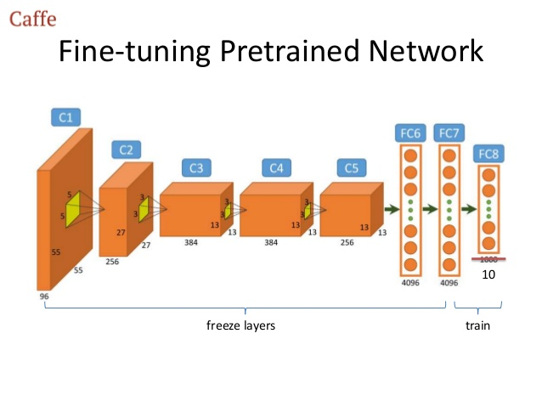
FINE TUNING IN A NN
Refers to transfer of learning ,occurs when we use knowledge that was gained from solving one problem and then apply it to a new but related problem.
Eg : knowledge obtained for recognizing cars are used for problem of recognizing trucks

Slide 36
Predicting With a Neural Network
Train
Labeled
Unlabeled
Test
Valid

Slide 37
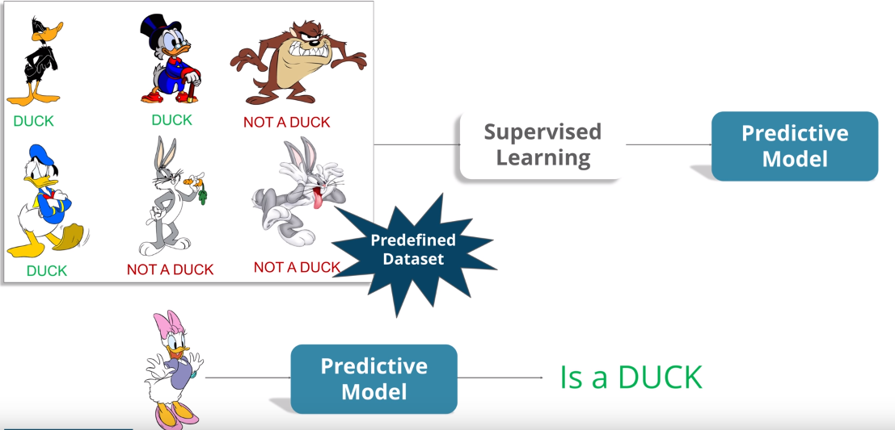
Supervised Learning

Slide 38




Use Cases

Slide 39
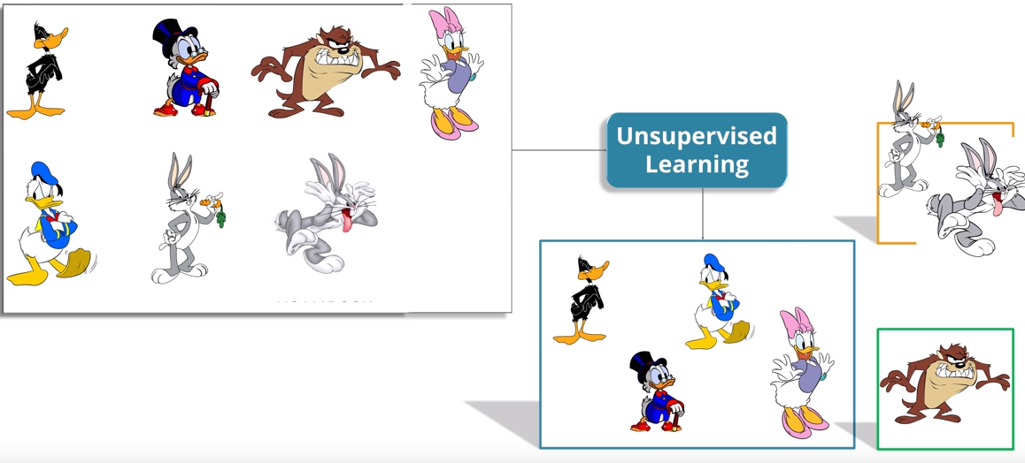
Unsupervised Learning

Slide 40


Use Cases

Slide 41
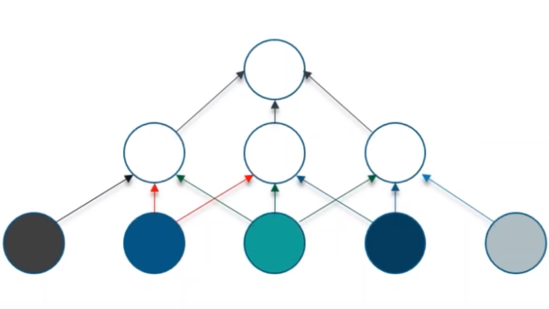
Convolutional Neural Network(CNN)
Special type of Artificial Neural Network
Handle less Amount Of Weights
Detect patterns or Features
It has Convolutional Layers

Slide 42
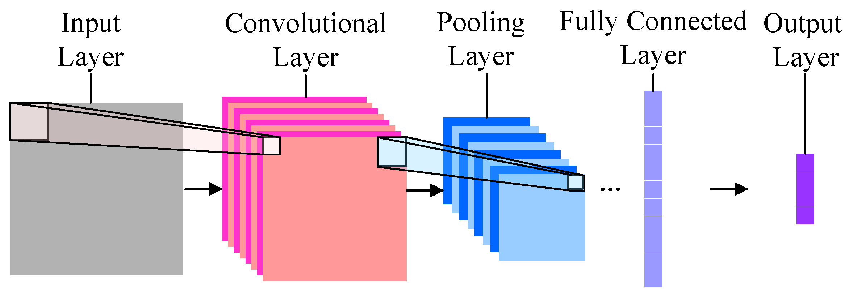
CNN Continue…..
CNN has Following layers
Convolutional layer
Pooling layer
Fully Connected

Slide 43
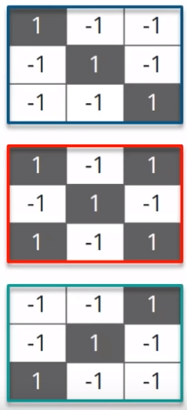
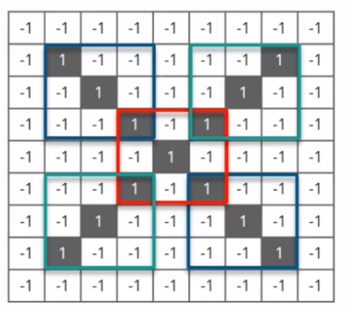
Convolutional Layer
Filters-Feature Extraction
Small Matrices

Slide 44
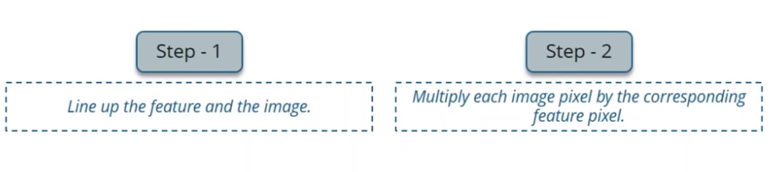
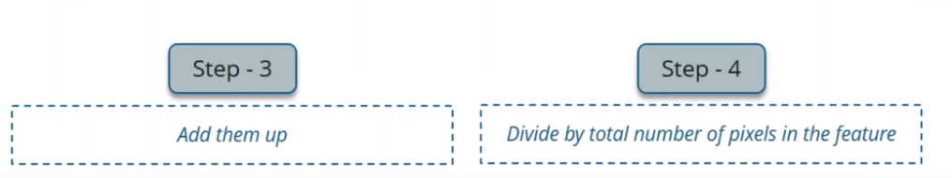
Continuation...

Slide 45
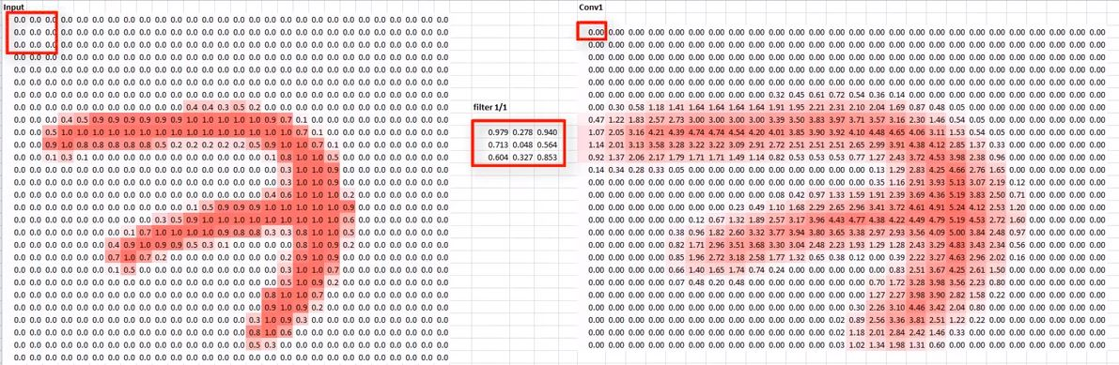
Continuation...

Slide 46
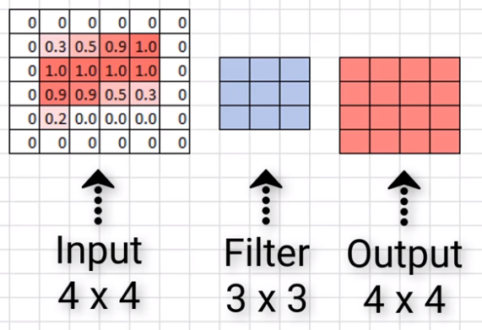
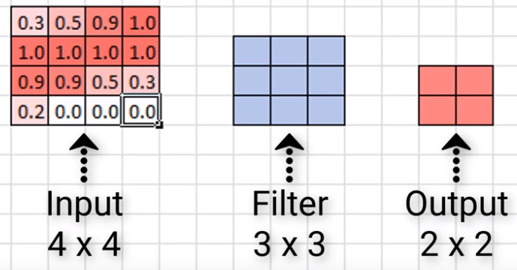
Zero Padding
Resulting output may become Meaningless
Lossing Valuable Information
Add a border of pixel with Zero

Slide 47
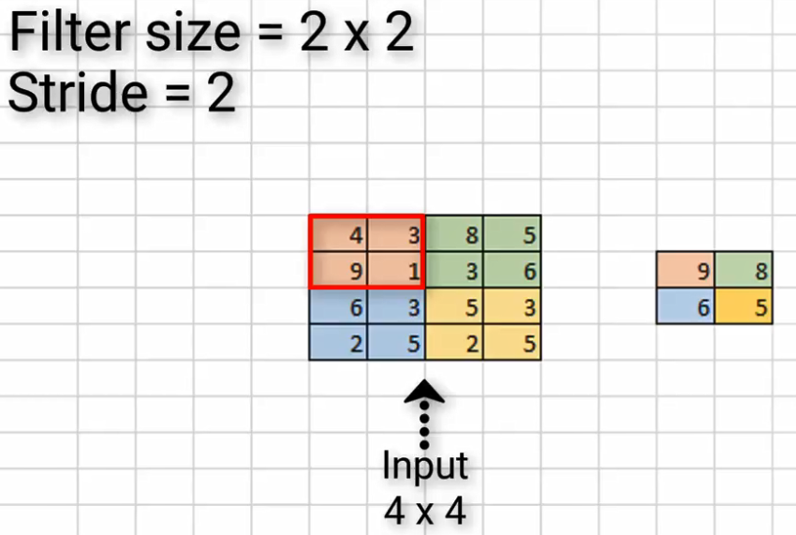
Pooling Layer
Shrink Image into smaller size
Pick a Window Size
Pick a Stride
Pass window through Filtered Image
From Each Window Take Max Value

Slide 48
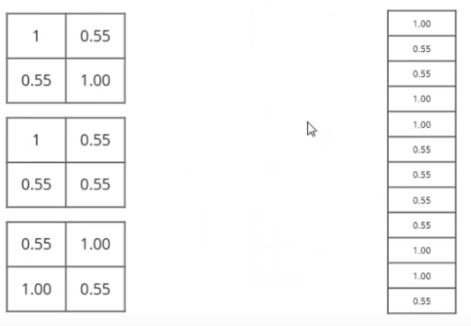
Fully Connected Layer
Shrinked Images Put Into Single List

Slide 49
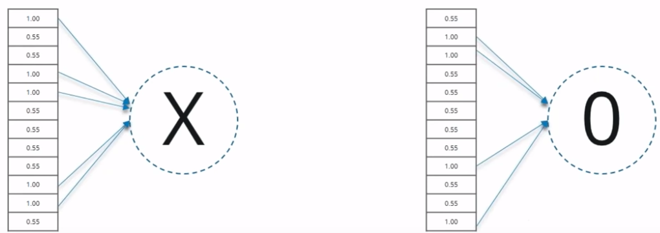
Fully Connected Layer Continue...

Slide 50
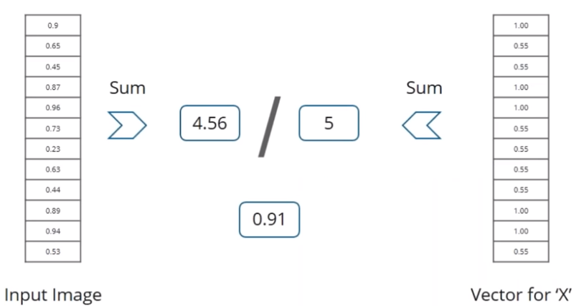
Output

Slide 51


CNN Application
Image Recognization
Object Detection

Slide 52
BACKPROPAGATION

Slide 53


Slide 54

The input data propagate forward

Slide 55
=>When network gives output, Calculate the Error/Loss. Ie, The difference between the value predicted by model and actual value.
=>Then minimize the error using SGD.

Slide 56


Slide 57


Slide 58


Slide 59


Slide 60


Slide 61


Slide 62


Slide 63


Slide 64


Slide 65


Slide 66


Slide 67


Slide 68


Slide 69
VANISHING GRADIENT
This is a problem that involves the earlier weight in the network
Sometimes the gradient w.r.to weight in the earlier layers of the network becomes vanishingly small
Weights are updated in some way that is proportional to the gradient.
Vanishing gradient prevent the the network to learn.
How it occurs?

Slide 70
EXPLODING GRADIENT GRADIENT
It is the opposite of vanishing gradient.
Gradient term becomes larger. ie, >1.
When updating using this gradient ,weight moves farther and farther from its original weight.

Slide 71
CONCLUSION
Deep Learning is on the roll and new exciting projects are revealed in various domains on a regular basis. We are going to describe the advancements in machine perception, reinforced learning and miscellaneous other apps over the course of the next couple of weeks, so stay tuned for the updates!!!!!!!

Slide 72
REFERENCE
https://www.analyticsvidhya.com/blog/2017/10/fundamentals-deep-learning-activation-functions-when-to-use-them/
https://www.analyticsvidhya.com/blog/2017/04/comparison-between-deep-learning-machine-learning/
https://becominghuman.ai/introduction-to-artificial-intelligence-5fba0148ec99
https://www.analyticsindiamag.com/10-games-successfully-integrated-artificial-intelligence/
https://www.expertsystem.com/examples-natural-language-processing-systems-artificial-intelligence/
https://www.youtube.com/watch?v=FbxTVRfQFuI
https://www.analyticsvidhya.com/blog/2017/10/fundamentals-deep-learning-activation-functions-when-to-use-them/
http://deeplizard.com/learn/video/m0pIlLfpXWE

Slide 73
Thank You

